Slide 1
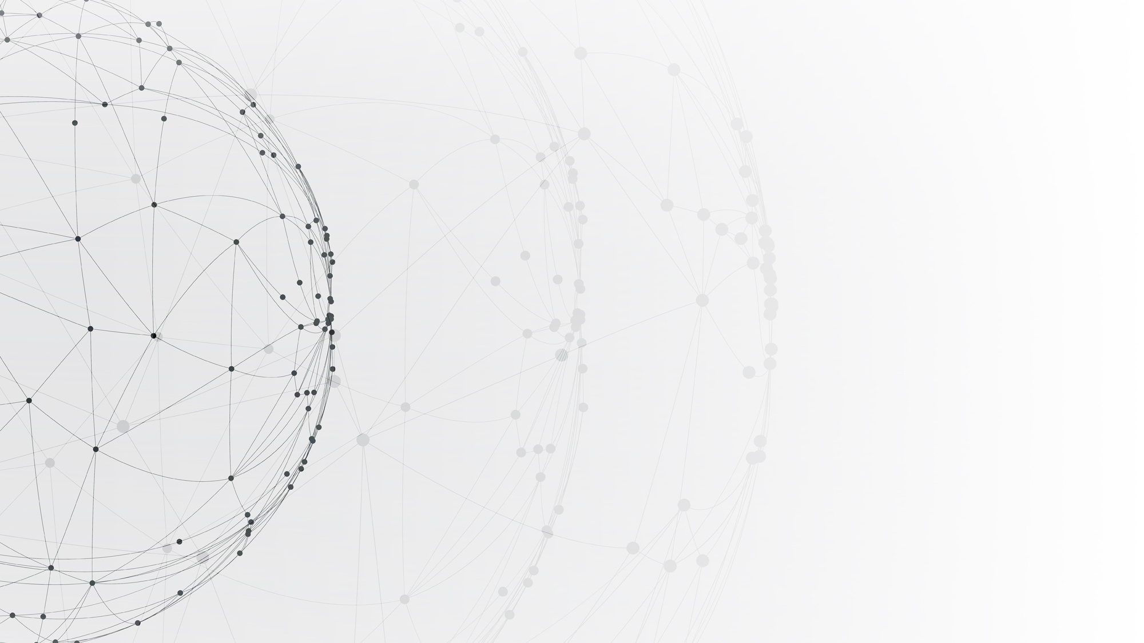
Reinforcement Learning
——Theory and Applications
Department of Computer Science and Engineering Msc in Computer Science
By Dong, Hanwen 2022.12.13

Slide 2
01
Background
02
Algorithms
CONTENTS
03
Experiments
04
Plan for Next Term

Slide 3
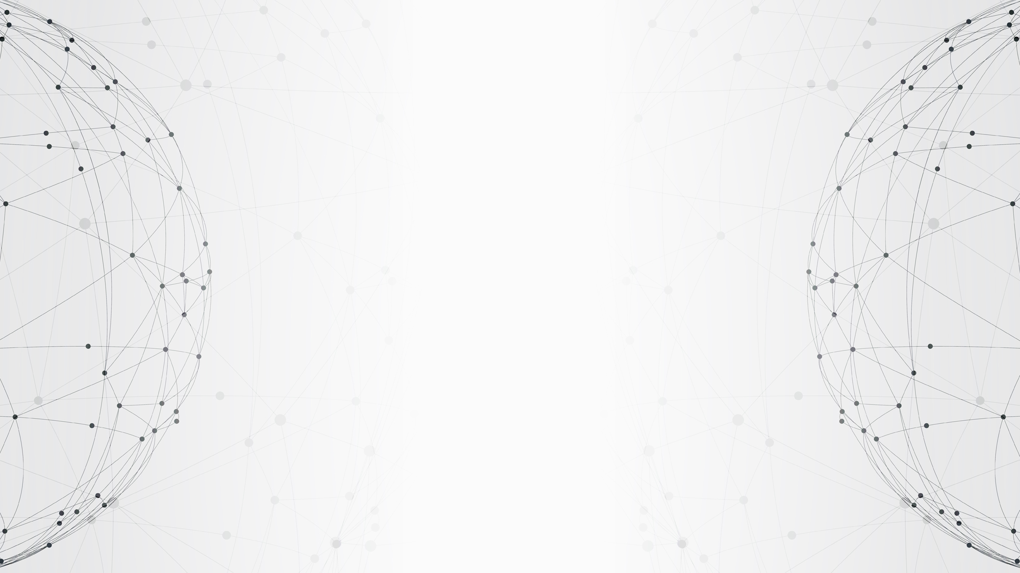
01
PART
Background

Slide 4
Setting
Reinforcement Learning(RL): Learn from environment through interactions in order to achieve a goal
Goal: Select actions to maximize cumulative rewards
Reward: A reward $R_{t}$ is a numerical feedback value at step t

Slide 5
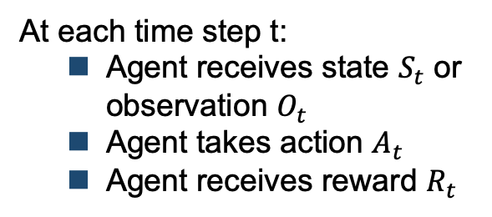
Setting
Agent
At each time step t:
Agent receives state $S_{t}$ or observation $O_{t}$
Agent takes action $A_{t}$
Agent receives reward $R_{t}$
Environment
Sequence: $S_{1}(O_{1})$, $A_{1}$, $R_{1}$, $S_{2}(O_{2})$, $A_{2}$, $R_{2}$ ... , $S_{t}(O_{t})$, $A_{t}$, $R_{t}$

Slide 6
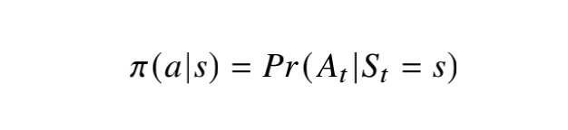
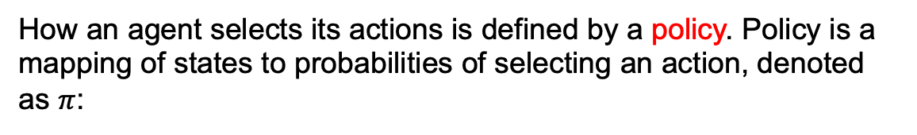
Setting
How an agent selects its actions is defined by a policy. Policy is a mapping of states to probabilities of selecting an action, denoted as $π$:

Slide 7
Value Functions
Value functions are predictions of future rewards
Two types: state value function and action value function

Slide 8
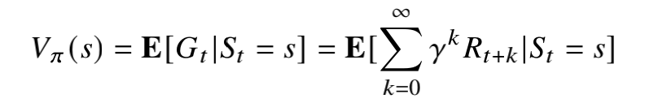
Value Functions
The state value function measures the goodness/badness of a state under a policy
It is the expected return starting from state s
Definition:

Slide 9
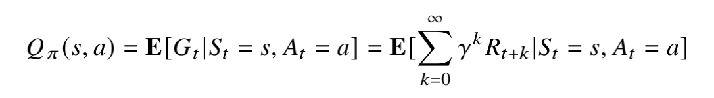
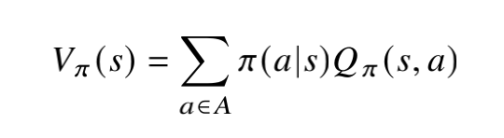
Value Functions
Action value function measures the goodness/badness of a state choosing action under a policy
Definition:
Relationship between $Q_{π}(s,a)$ and $V_{π}(s)$:

Slide 10
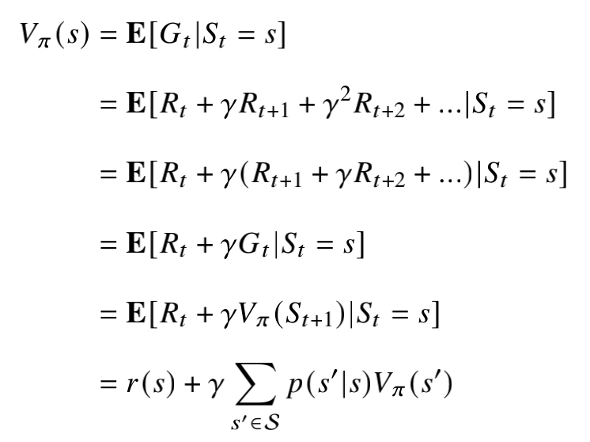
Bellman Expectation Equation
Value functions satisfy recursive relationships:

Slide 11
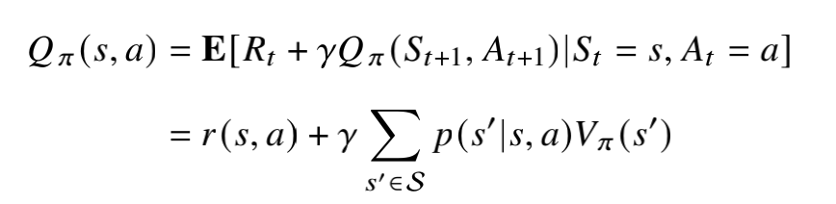
Bellman Expectation Equation
Similarly, $Q_{π}(s,a)$ can also be expanded as:

Slide 12
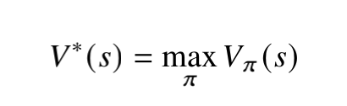
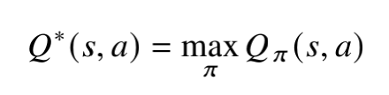
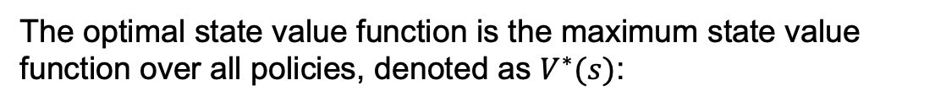
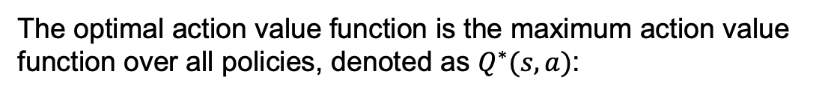
Optimal Value Functions
The optimal state value function is the maximum state value function over all policies, denoted as $V^{∗}(s)$:
The optimal action value function is the maximum action value function over all policies, denoted as $Q^{∗}(s,a)$:

Slide 13
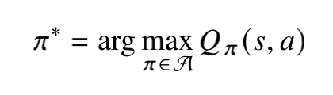
Optimal Policy
The optimal policy $π^{∗}$ can be obtained directly from $Q^{∗}(s,a)$:
The optimal policy $π^{∗}$ maximizes $Q_{π}(s,a)$. Same for $V_{π}\left(s\right)$

Slide 14
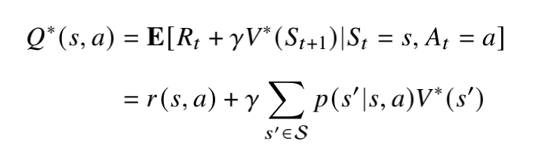
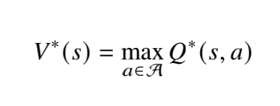
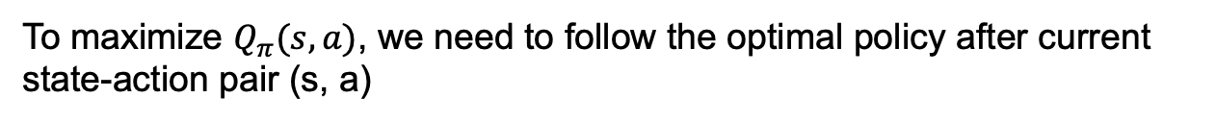
Bellman Optimality Equations
To maximize $Q_{π}(s,a)$, we need to follow the optimal policy after current state-action pair (s, a)
To maximize $V_{π}(s)$, select the action that maximizes optimal action value

Slide 15
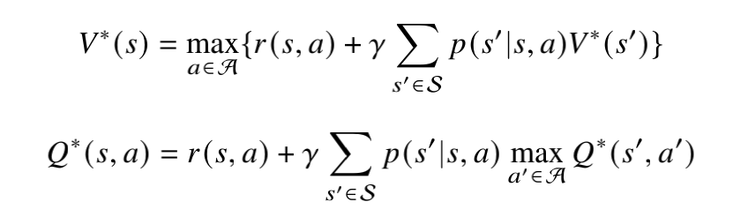
Bellman Optimality Equations
Based on the relationship between $V^{∗}(s)$ and $Q^{∗}(s,a)$, we have

Slide 16
02
PART
Algorithms

Slide 17
Algorithms
Dynamic Programming
Policy Iteration
Value Iteration
Monte Carlo Methods
Temporal Difference Learning
Q-learning
SARSA
Deep Q-Network

Slide 18
Dynamic Programming
Policy Iteration
Policy Evaluation
Policy Improvement
Value Iteration

Slide 19
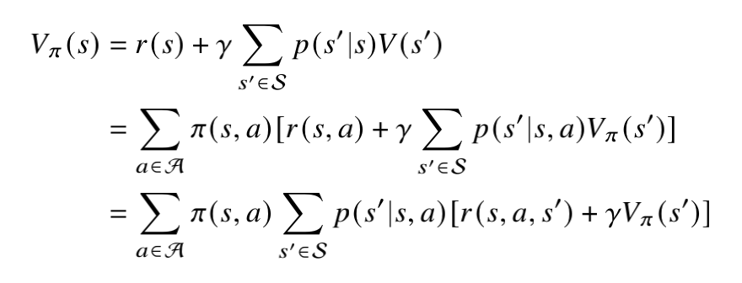
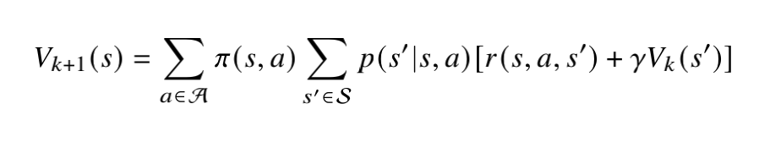
Policy Evaluation
Policy evaluation is the process of calculating a policy’s state-value function.
Bellman expectation equation for $V_{π}(s)$:

Slide 20
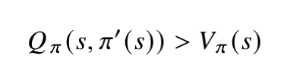
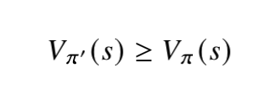
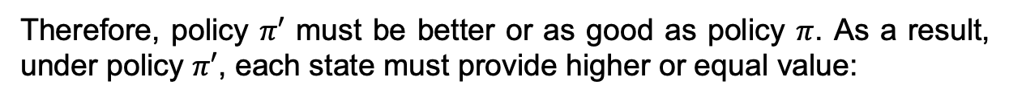
Policy Improvement
Consider each state s. Assume that a deterministic policy $π′$, for each state s, meets the following condition:
Therefore, policy $π′$ must be better or as good as policy $π$. As a result, under policy $π′$, each state must provide higher or equal value:

Slide 21
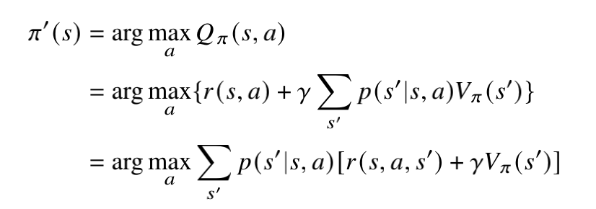
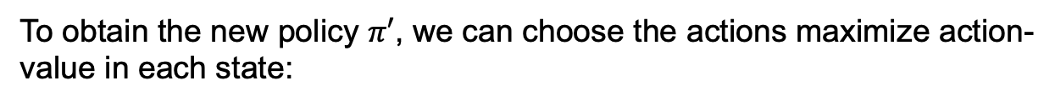
Policy Improvement
To obtain the new policy $π′$, we can choose the actions maximize action-value in each state:

Slide 22
Policy Iteration
The process of policy iteration:

Slide 23
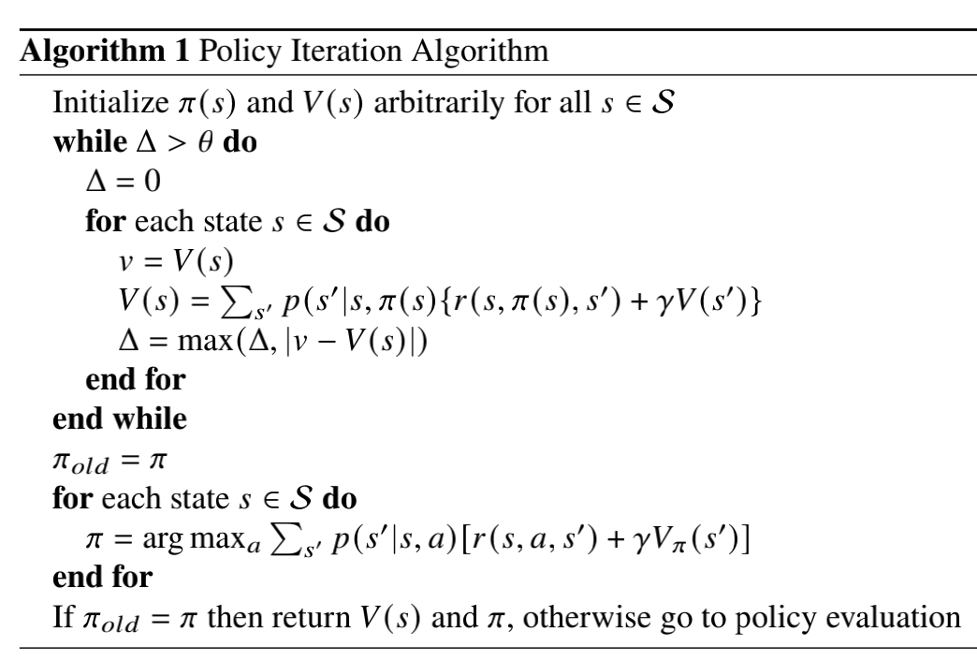
Policy Iteration

Slide 24
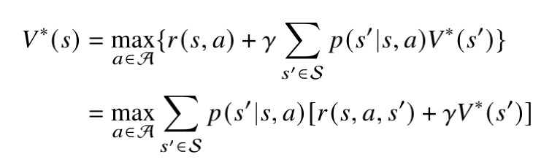
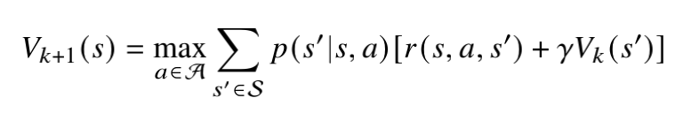
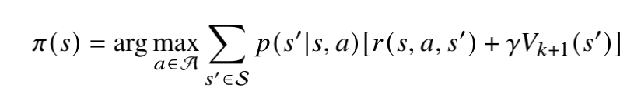
Value Iteration
Value iteration updates the value function using the Bellman optimality equation:
Choose the policy that maximizes the value function for each state s:

Slide 25
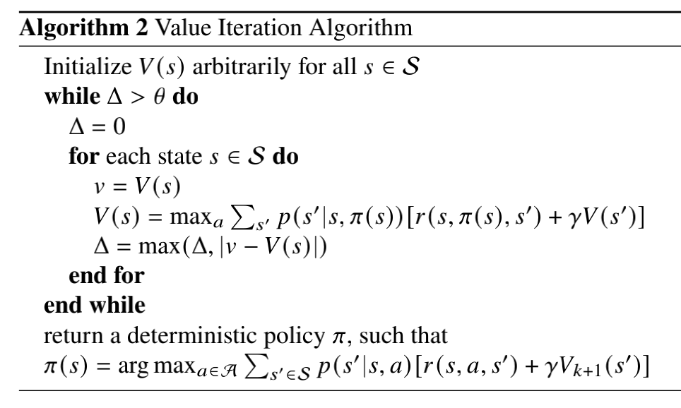
Value Iteration

Slide 26
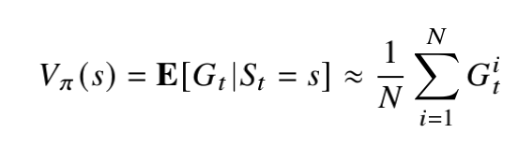
Monte Carlo Methods
A state’s value is equal to its expected return
We use a policy to sample many sequences, calculate the returns from a particular state
As more returns are sampled, the average return should converge to the expected value(by the law of large numbers)

Slide 27
Monte Carlo Methods
Every-visit Monte Carlo
Calculate the average of the returns following each visit to state 𝑠 in a collection of episodes.
First-visit Monte Carlo
The cumulative reward is computed only when this state comes for the first time in this sequence.

Slide 28
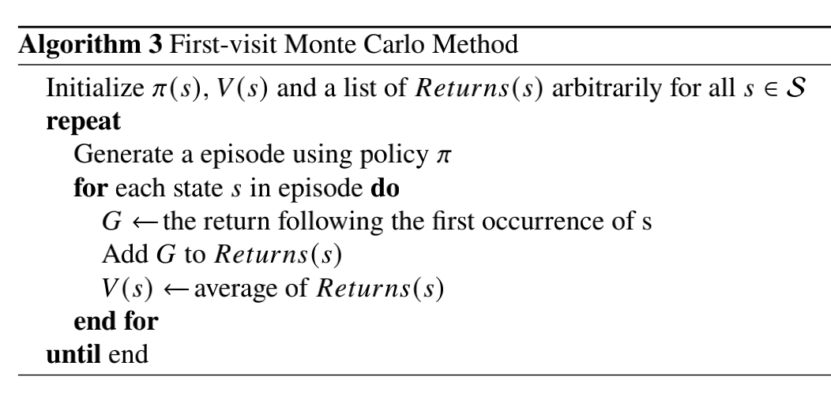
Monte Carlo Methods

Slide 29
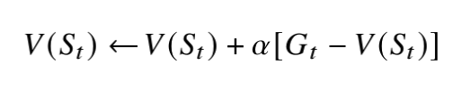
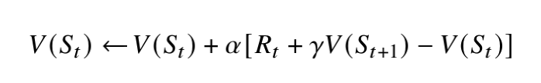
Temporal Difference Learning
For Monte Carlo methods, we rewrite the updating form of value function as an incremental way:
Temporal difference(TD) error
Updating formula of TD learning:
(TD(0))

Slide 30
Temporal Difference Learning
SARSA
Q-learning

Slide 31
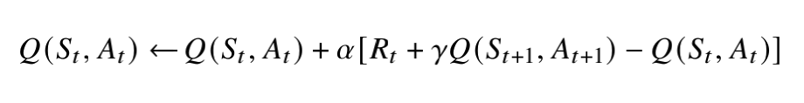
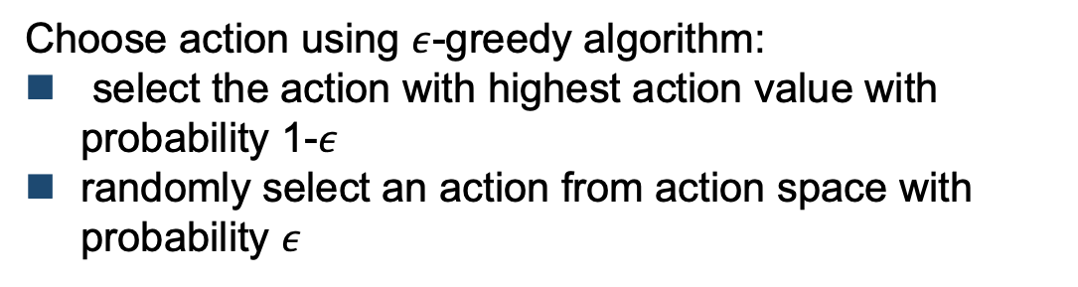
SARSA
SARSA updates action-value function based on the idea of TD(0):
Choose action using $ε$-greedy algorithm:
select the action with highest action value with probability 1-$ε$
randomly select an action from action space with probability $ε$

Slide 32
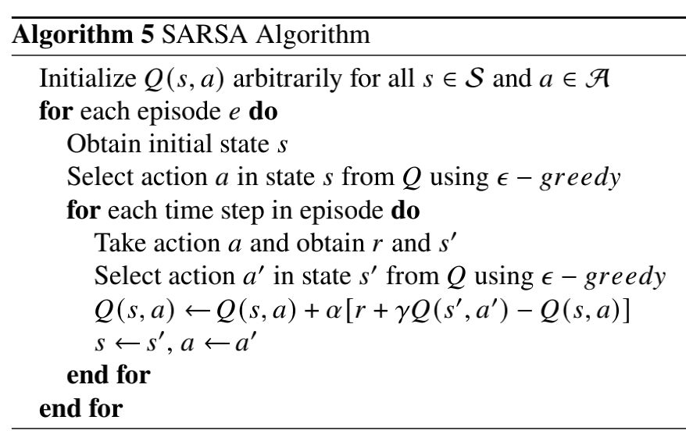
SARSA

Slide 33
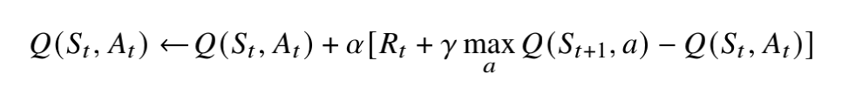
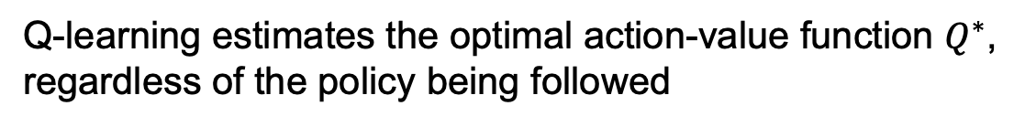
Q-learning
Q-learning estimates the optimal action-value function $Q^{∗}$, regardless of the policy being followed

Slide 34
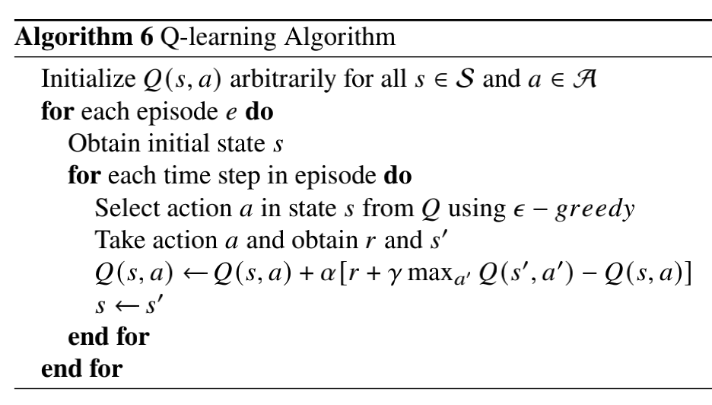
Q-learning

Slide 35
Deep Q-Network
Deep Q-network (DQN) uses neural network to estimate and fit the Q function
DQN works quite well when states and actions are continuous
If action is discrete(finite), input the state and output the value for each action
If action is continuous(infinite), input the state and action and output the value of performing this action in the state

Slide 36
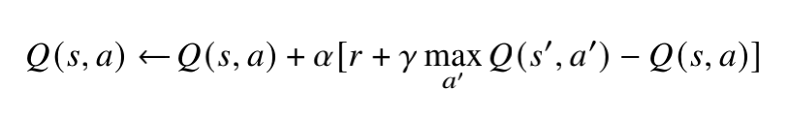
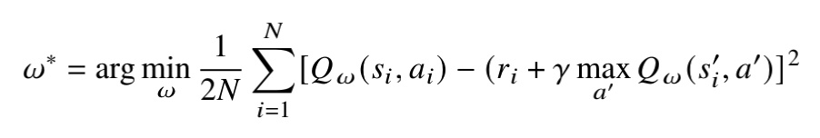
Loss function
Target
Updating rule for Q-learning:
Loss function based on mean square root(MSE):

Slide 37
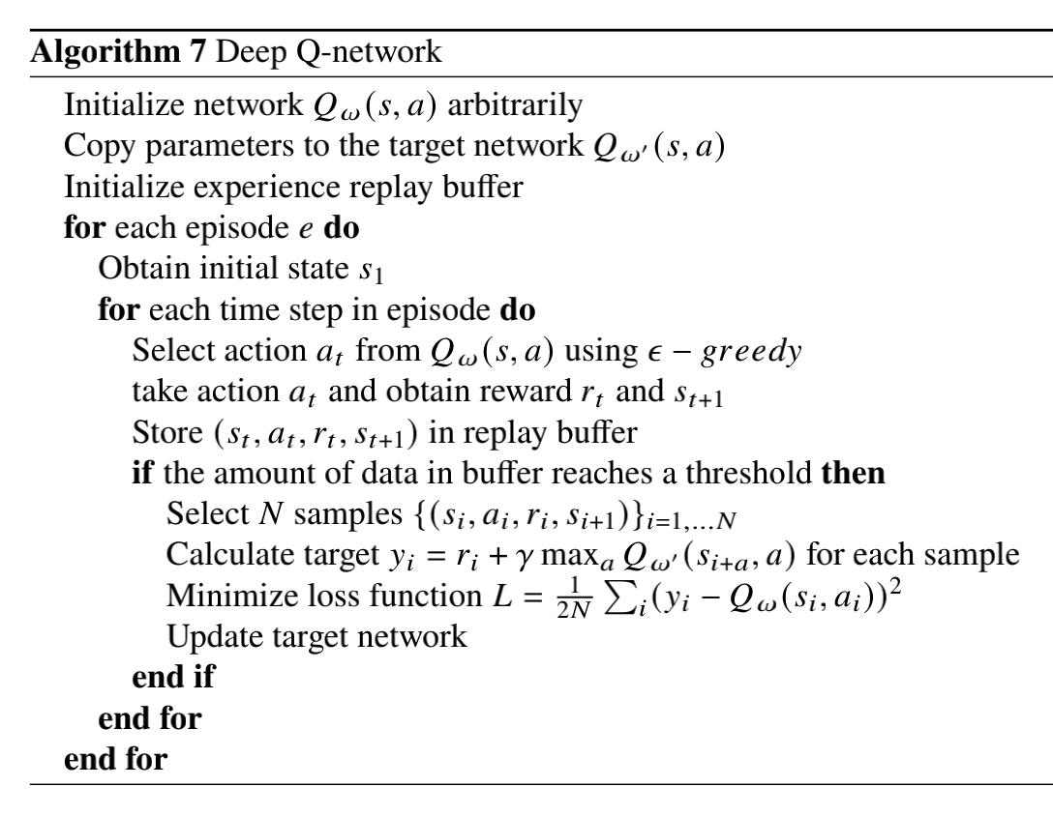
Deep Q-Network

Slide 38
03
PART
Experiments

Slide 39
Environment Setting
Frozen Lake
Cart Pole

Slide 40
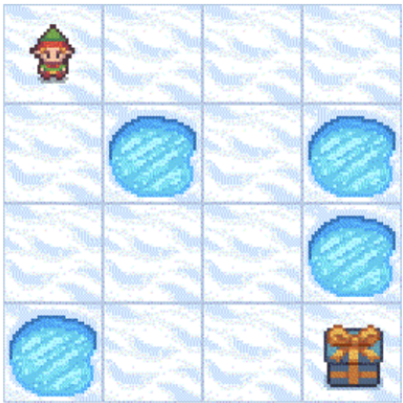
Frozen Lake
There are 4 actions for agent represented by 4 numbers, which are 0: LEFT, 1: DOWN, 2: RIGHT, 3: UP. The state, calculated by (current row )* nrows + (current col). The row and col both start at 0. For example, the goal position can be calculated as: 3 * 4 + 3 = 15
Reward for termination: 1

Slide 41
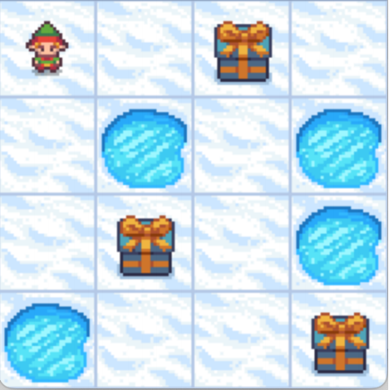
Frozen Lake
We added two small rewards called gifts to frozen lake. In the figure, the gift states are 2 and 9. Each gift can be picked up only once. We will use this in dynamic programming and Monte Carlo method.
Reward for this gift: 35
Reward for this gift: 16
Reward for termination: 50

Slide 42
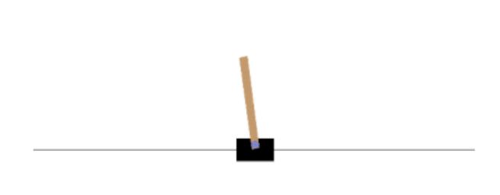
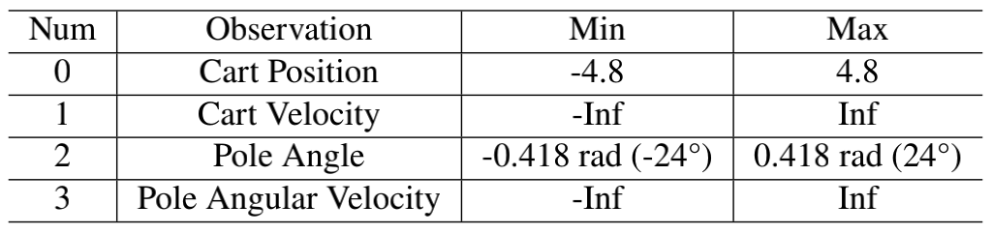
Cart Pole
Reward +1 for each step is given
Maximum reward is 475
This will be used in Q-learning, SARSA and DQN

Slide 43
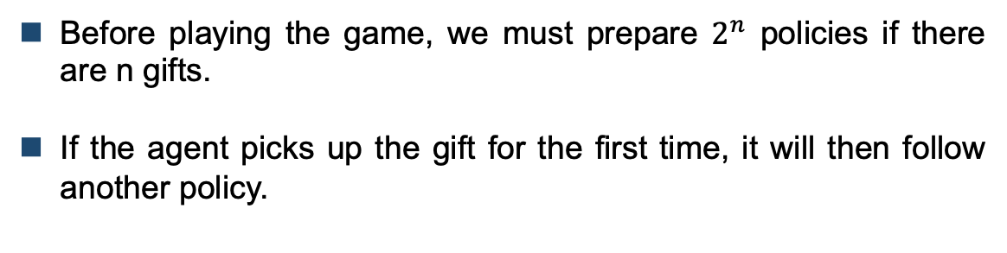
Dynamic Programming
Problem:
Since the transition probability matrix must be modified once the agent steps into ‘gift state’, the policy should also be modified.
Solutions:
Before playing the game, we must prepare $2^{n}$ policies if there are n gifts.
If the agent picks up the gift for the first time, it will then follow another policy.

Slide 44
Dynamic Programming
There are 2 gifts in frozen lake. We need to prepare 4 policies, which corresponds to 4 situations:
Both gifts have not yet been picked up
Gift 1 has been picked up while gift 2 remains still
Gift 2 has been picked up while gift 1 remains still
Both gifts have been picked up
If the agent picks up the gift for the first time, it will then follow the corresponding policy.

Slide 45
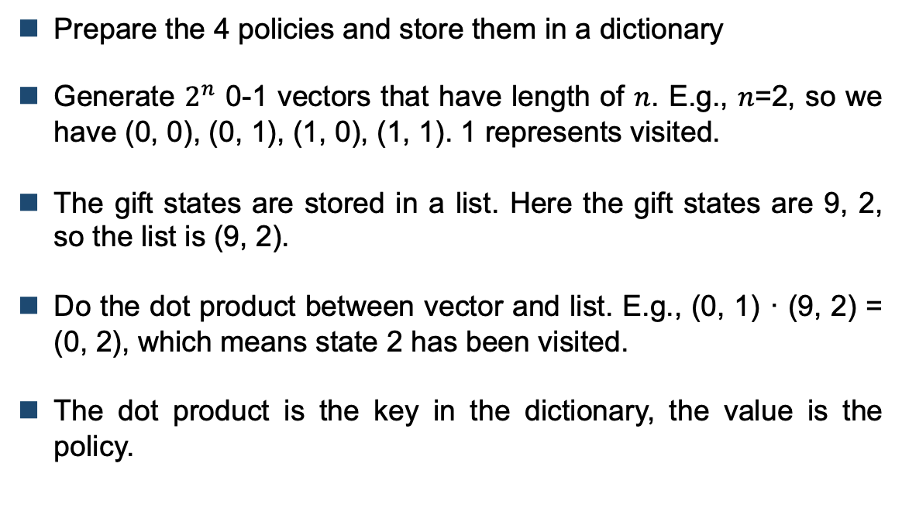
Dynamic Programming
To find which policy the agent should follow:
Prepare the 4 policies and store them in a dictionary
Generate $2^{n}$ 0-1 vectors that have length of 𝑛. E.g., 𝑛=2, so we have (0, 0), (0, 1), (1, 0), (1, 1). 1 represents visited.
The gift states are stored in a list. Here the gift states are 9, 2, so the list is (9, 2).
Do the dot product between vector and list. E.g., (0, 1) · (9, 2) = (0, 2), which means state 2 has been visited.
The dot product is the key in the dictionary, the value is the policy.

Slide 46
Dynamic Programming
To find which policy the agent should follow
Take (0, 2) as an example. Its corresponding policy is the one evaluated under the situation where state 2 has been visited and state 9 has not been visited.
When playing game, we will check whether each gift state has been visited and then find the corresponding policy for agent in the dictionary.

Slide 47

Results for Policy Iteration
The 4 policies under 4 situations generated by policy iteration

Slide 48


Results for Policy Iteration
The 2 paths generated by policy iteration

Slide 49

Results for Policy Iteration
After testing 100 episodes:

Slide 50

Results for Value Iteration
The 4 policies under 4 situations generated by value iteration

Slide 51
Results for Value Iteration
After testing 100 episodes:

Slide 52

Monte Carlo Methods
We trained about 300 episodes and recorded the average return that the agent get in each episode.

Slide 53



Monte Carlo Methods

Slide 54

Monte Carlo Methods
After testing 100 episodes:

Slide 55

SARSA
Problem:
Each observation in cart pole environment has 4 elements.
Each element is a continuous number
We cannot use $Q(s, a)$
Solutions:
Discretize the observation into a tuple containing 4 integers
Convert this tuple into an integer representing the state

Slide 56
SARSA
Convert observation into integer tuple:
We need a function from Numpy in Python called digitize
Given an input array 𝑥 and an array of bins, it will return an array of index where each index 𝑖 satisfies 𝑏𝑖𝑛[𝑖 - 1] ≤ 𝑥 < 𝑏𝑖𝑛[𝑖]
E.g., given an input 𝑥 = [0.2, 2.5] and a bin [0, 2, 4], this function will return [1, 2] since 𝑏𝑖𝑛[0] ≤ 0.2 < 𝑏𝑖𝑛[1] and 𝑏𝑖𝑛[1] ≤ 2.5 < 𝑏𝑖𝑛[2].
𝑥 is the observation and bin is its range.

Slide 57
SARSA
Example of cart position:
The range of cart position is (−2.4, 2.4)
We divided the range into 8 smaller ranges, which is (−2.4, -1.8, -1.2, -0.6, 0, 0.6, 1.2, 1.8, 2.4)
Given a continuous data cart position such as -2.3456, we can map this value to an integer 1.

Slide 58
SARSA
Convert integer tuple into integer state:
We divided the range into 8 small ranges, which means that each element in the integer tuple actually has 8 possible values.
We can perceive the tuple as an octal number.
Convert this octal number into a decimal number.

Slide 59


SARSA
We trained about 1000 episodes for SARSA:

Slide 60


Q-learning
We trained about 1000 episodes for Q-learning:

Slide 61
Ways to Improve
One way to improve is to increase the number of discrete states, meaning that we need to divide the range of each element in the observation into more small ranges.
If we divide the range into infinitely small ranges, then each small range actually corresponds to a real number. Every continuous state will correspond to a discrete state.

Slide 62


Ways to Improve
Average reward: 33.599
Average reward: 36.691
Divide into 16 ranges
Divide into 32 ranges

Slide 63
Ways to Improve
Another way to improve is to give a punishment to agent when an episode ends.
Punishment: if the current episode terminates, then set the reward to a negative number, e.g., -100, no matter how many rewards the agent gets

Slide 64




Ways to Improve

Slide 65


Ways to Improve

Slide 66
Deep Q-Network
Basic structure:
Our DQN has one hidden layer with 128 neurons.
Input layer has 4 neurons, corresponding to 4 elements in observation. Output layer has 2 neurons, corresponding to 2 actions in action space
Hidden layer uses ReLU as activation function. Optimizer is Adam.
We take each observation as an input and output the action value for this observation

Slide 67


Deep Q-Network
After training 1000 episodes:

Slide 68

Deep Q-Network
After training 1000 episodes:

Slide 69




Deep Q-Network

Slide 70

Deep Q-Network
Results for 2 hidden layers DQN:
Results for 3 hidden layers DQN:

Slide 71
04
PART
Plan for Next Term

Slide 72
Plan for Next Term
Learn about AlphaGo Zero and implement it:
I will read some literature about AlphaGo Zero. I will try to figure out its principles, basic structure and related algorithms such as MCTS and CNN
I will try to implement it using Python, Pytorch or Tensorflow.
I am going to use the implemented algorithm to play a simple game, Gobang. I will train the model and make it able to play with humans.
The final deliverable will be a system based on the framework of AlphaGo Zero that enables humans to play Gobang with the machine.

Slide 73
THANKS

